Slide 1



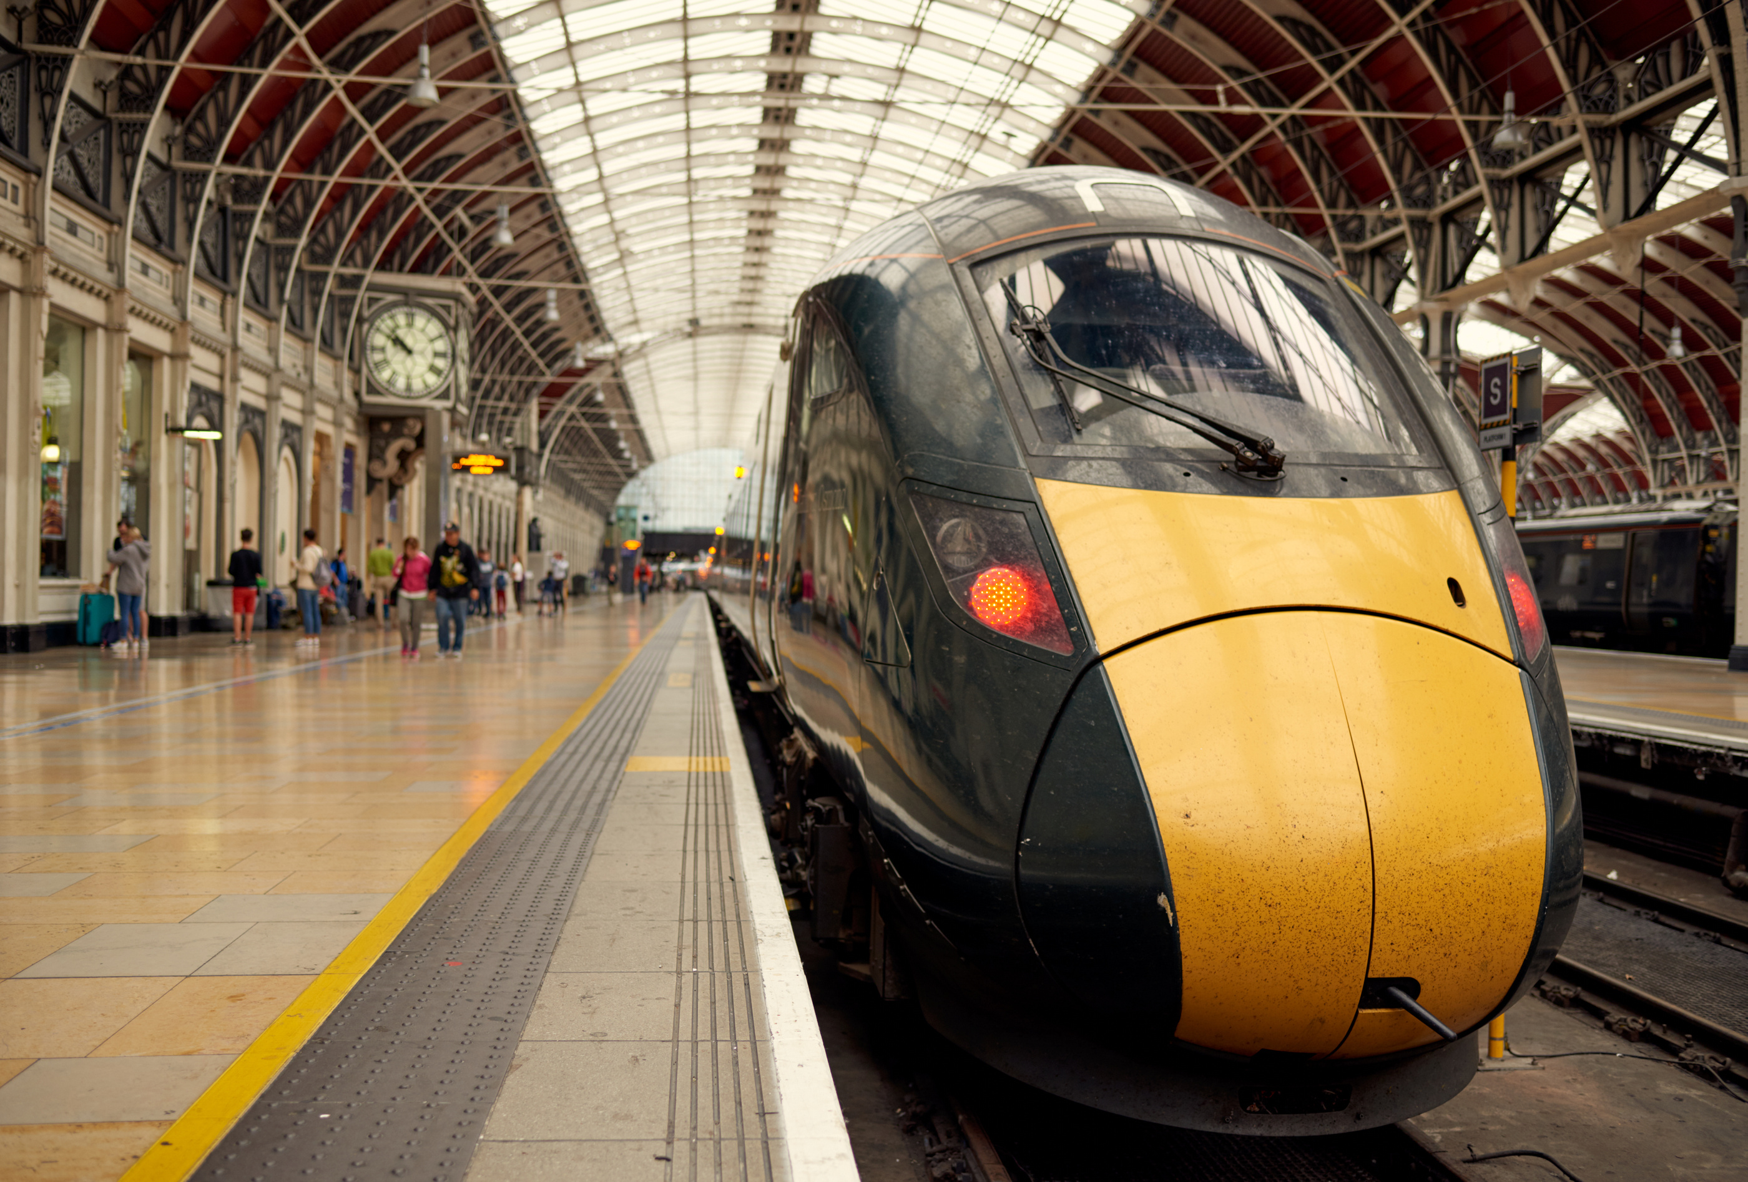
MetroMove Transit Solutions.
PUBLIC TRANSPORTATION
Insights & Recommendations for Efficient, Affordable, and Timely Public Transport
Presented By:
Muinat Tijani

Slide 2
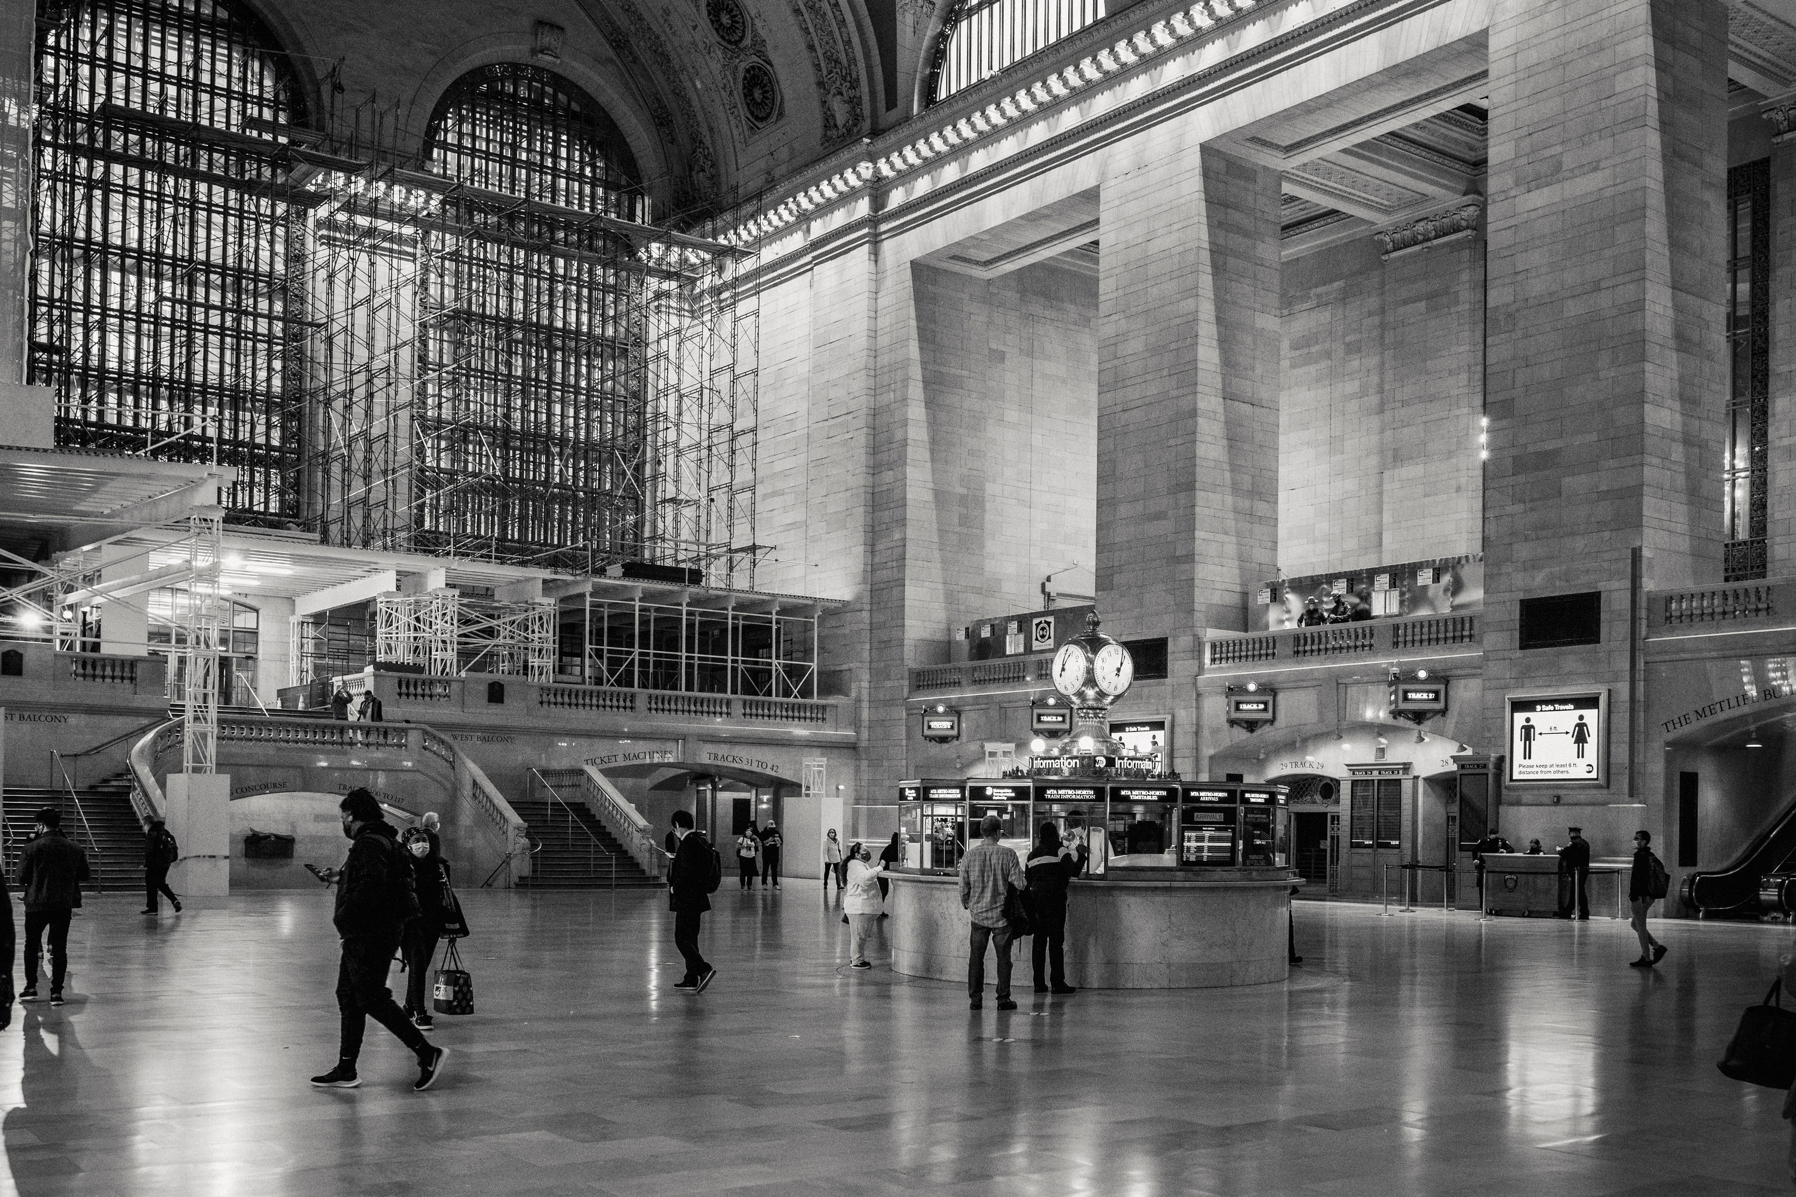



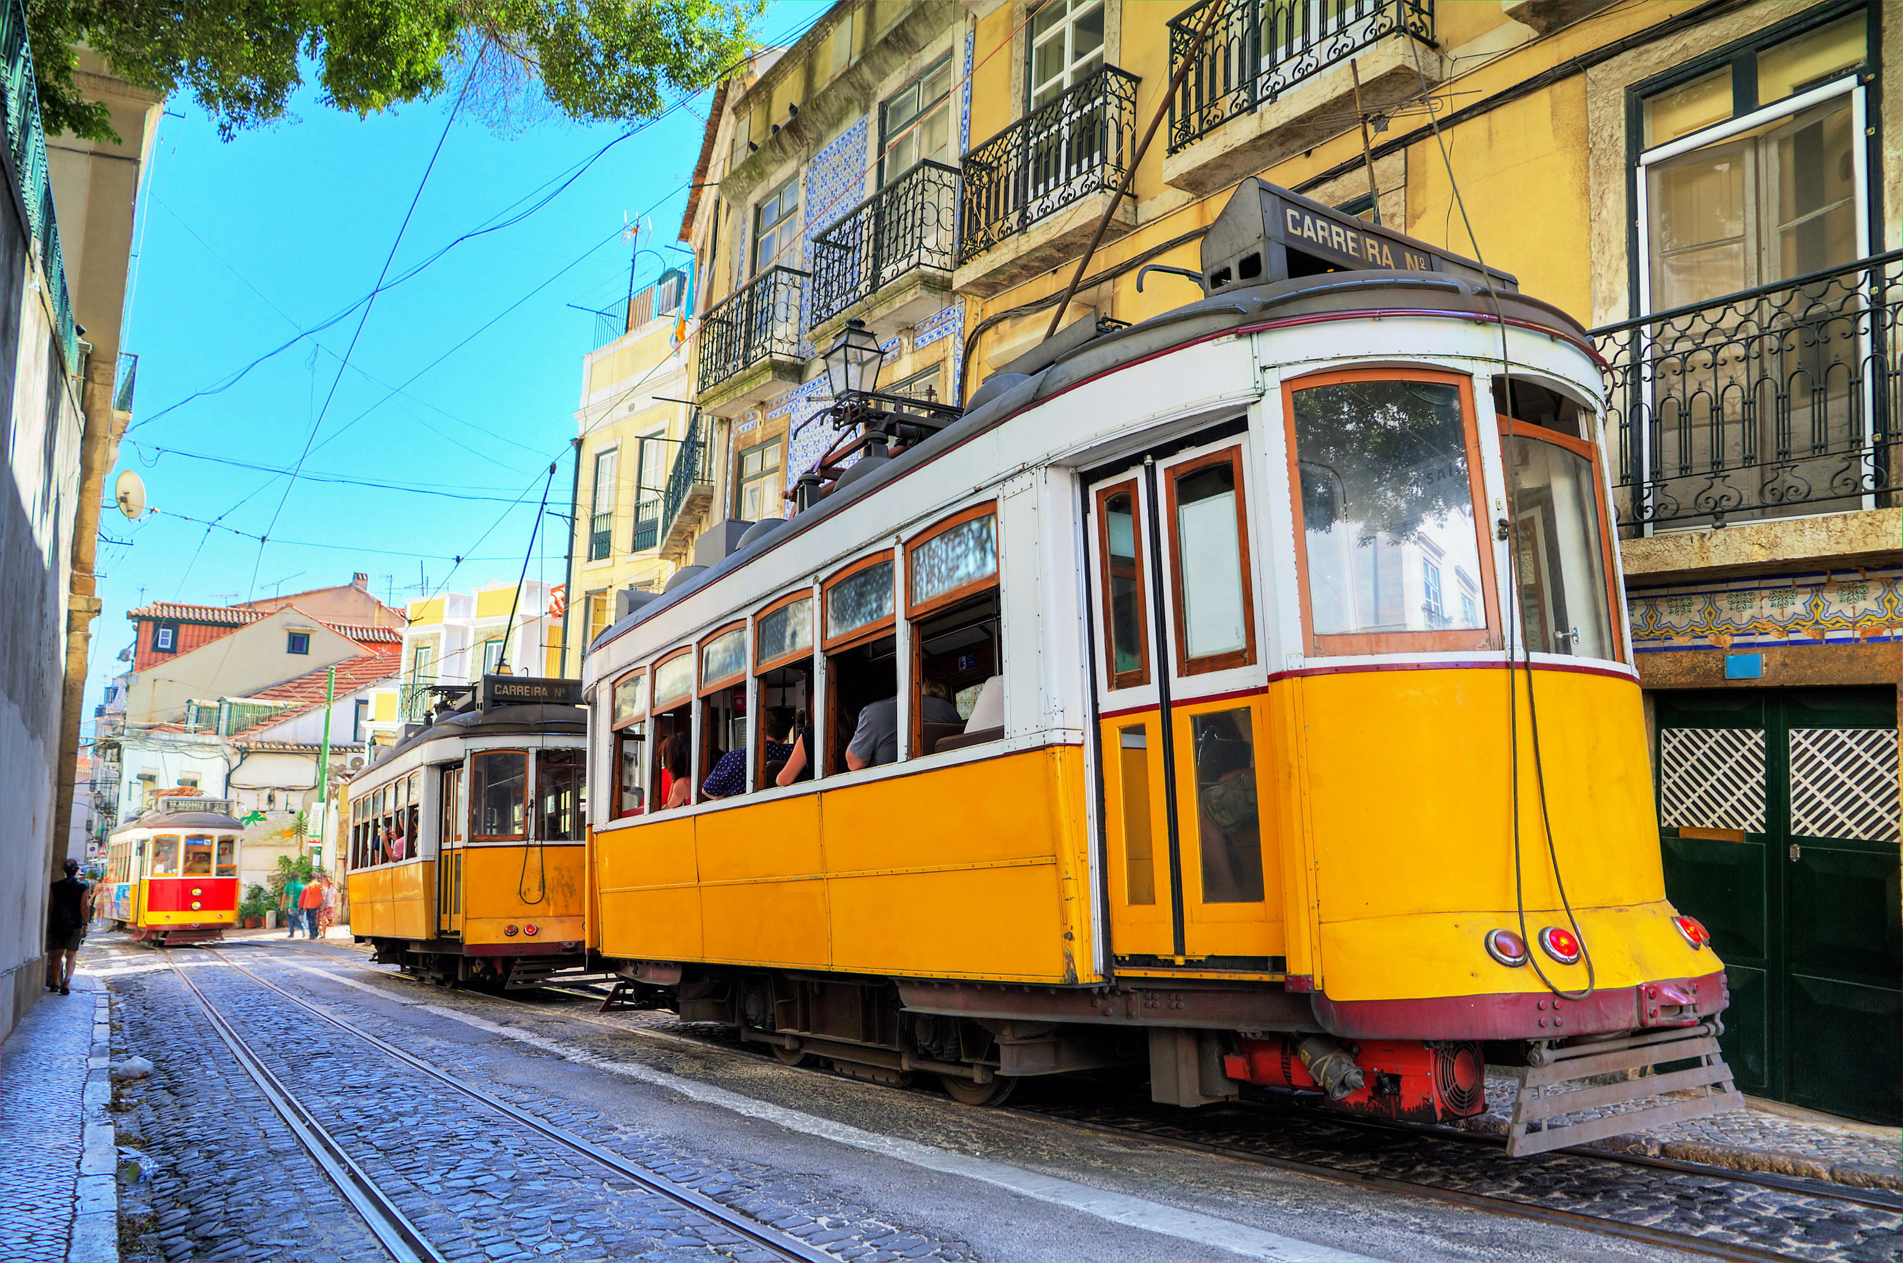
MetroMove Transit Solutions.
INTRODUCTION
MetroMove Transit Solutions is a public transportation service provider operating in multiple cities.
They manage and analyse thousands of daily trips taken via buses, trains, ferries, and trams.
MetroMove aims to provide efficient, affordable, and timely public transportation.

Slide 3

MetroMove Transit Solutions.
PROBLEM
STATEMENTS
BUS
TRAM
TRAIN
FERRY
MetroMove holds a wealth of trip data, but much of it is inconsistent and incomplete, making it hard to draw useful insights.
By cleaning and exploring this data, we can uncover patterns in journeys, passenger behaviour, and fares.
These insights will guide smarter decisions, improve efficiency, and enhance the passenger experience.

Slide 4
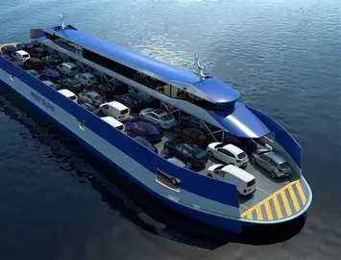
MetroMove Transit Solutions.
RATIONALE FOR THE
PROJECT
FERRY
Evaluating the performance of different transport modes.
Analysing how trip characteristics impact customer experience.
Requiring cleaning and preprocessing of raw data.
Encouraging pattern discovery through exploratory data analysis.
Understanding passenger usage patterns.

Slide 5
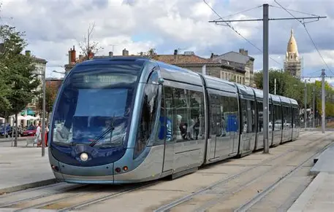
MetroMove Transit Solutions.
TRAM
PROJECT
WORKFLOW
Importation of necessary Libraries
Handling Outliers
Data Loading
Case Formatting
Drop Unknow Features
Strip White Space
Handling Missing Values
Descriptive Statistics and EDA
Handling Duplicates

Slide 6
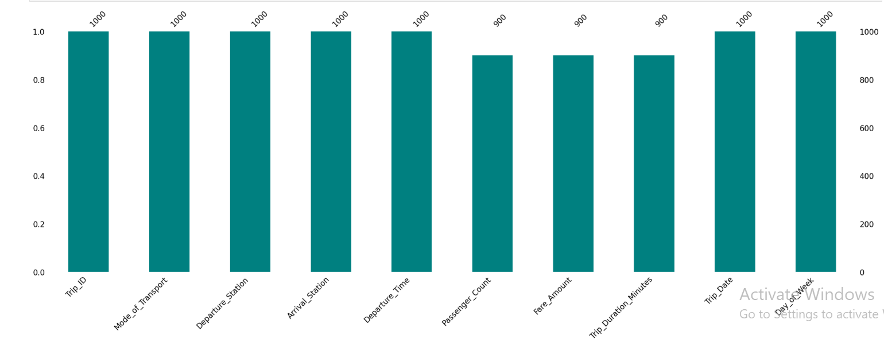
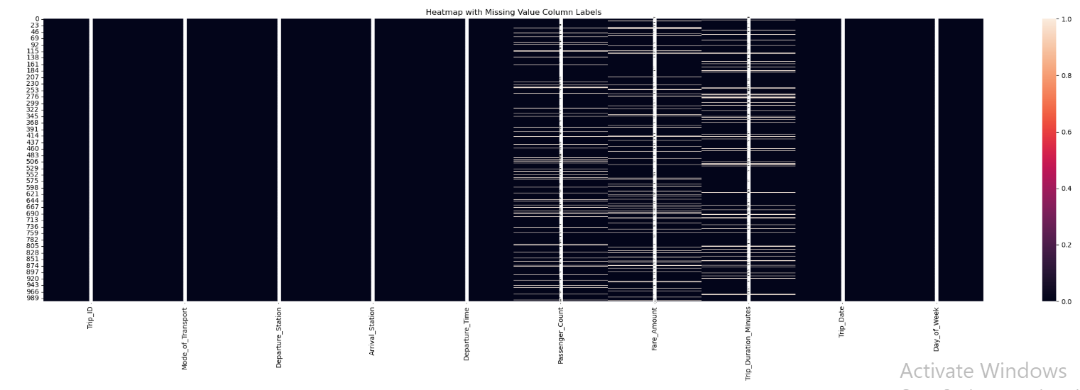
MetroMove Transit Solutions.
MISSING NUMBERS IN THE DATASET

Slide 7
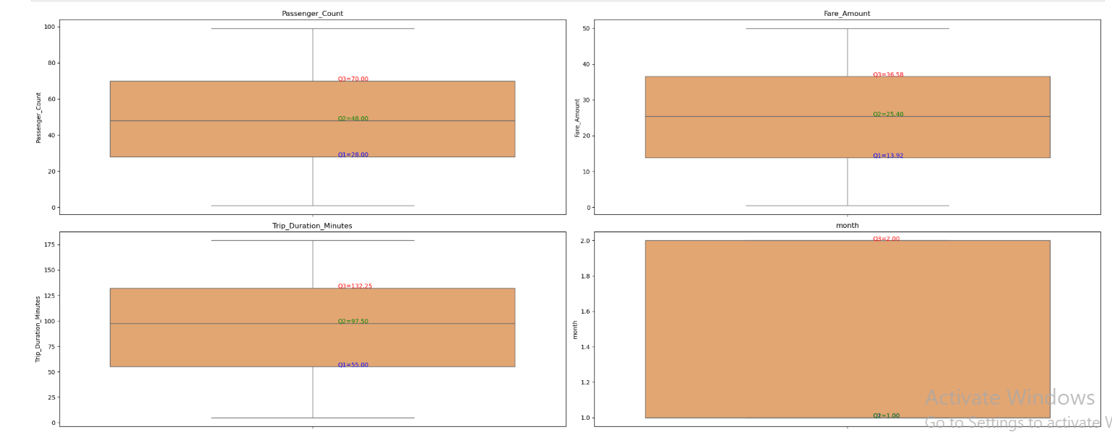
MetroMove Transit Solutions.
DESCRIPTIVE
STATISTICS
Descriptive Summary
 | Mean | Median | StD | IQR
Fare Amount | 25.37 | 25.40 | 13.72 | 22.66
Passenger Count | 49.04 | 48.00 | 26.278 | 42.00
Trip Duration (mins) | 94.59 | 97.50 | 48.04 | 77.25
Table 1: Representation of Descriptive Statistic of numerical features
Figure 1: Boxplot Chart representation of Mean, Median, Percentiles
Fares are fairly consistent with slight variability, reflecting differences in trip distance or service type.
Passenger numbers vary widely, some trips are near full capacity, while others have far fewer riders. This indicates uneven demand patterns.
Average trips take ~95 minutes, but duration varies greatly depending on route and traffic, suggesting areas for efficiency improvement.

Slide 8
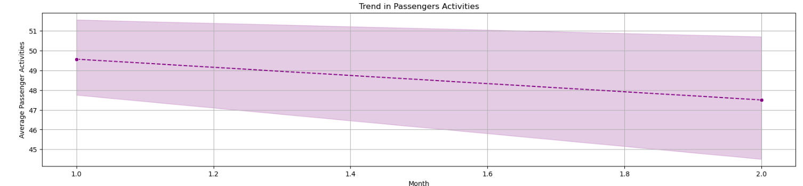
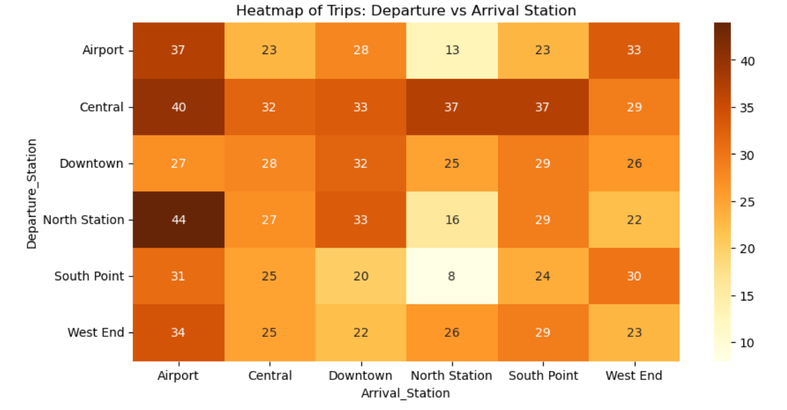
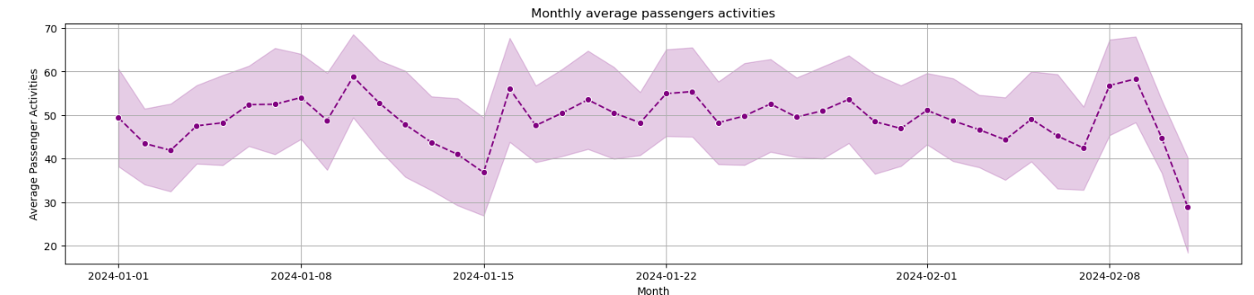
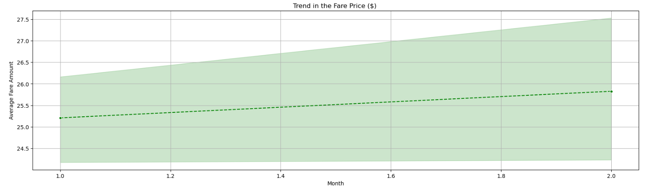
MetroMove Transit Solutions.
PASSENGER BEHAVIOUR
Figure 2: Heatmap Chart representation of Department vs Arrival Station
Central Station is the main starting point, Airport is the top destination.
Demand peaks in January and is lower in February.
South Point → North Station (only 8 trips)This suggest not many people travel between South Point and North station.
Figure 3: Line Chart representation trend in people behaviour
West End flows has moderate connections across all stations (values mostly 22–34). It plays more of a secondary hub role.

Slide 9
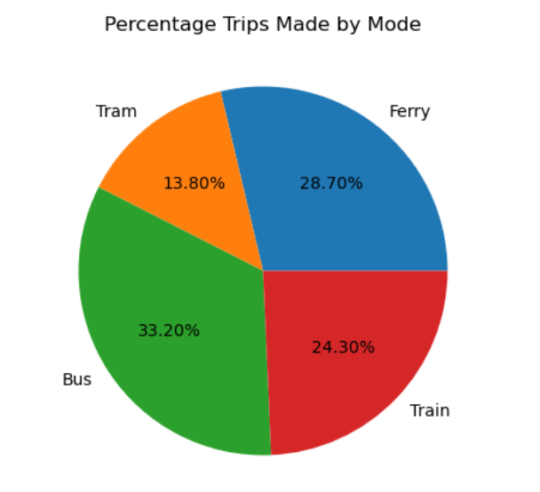
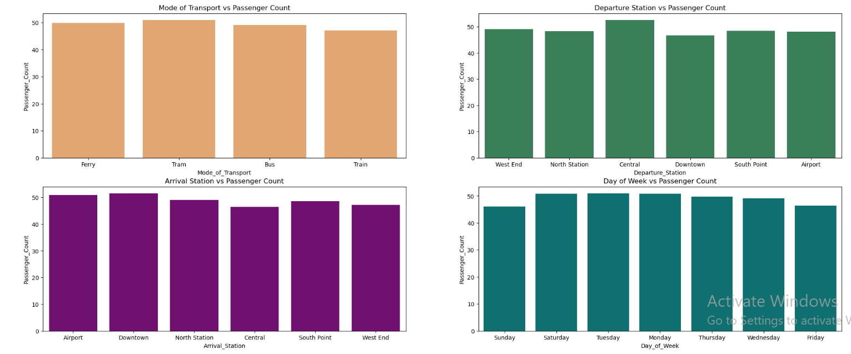
MetroMove Transit Solutions.
PASSENGER BEHAVIOUR CONTINUES..
Figure 4: Bar Chart representation of people behaviour
Figure 5: Pie Chart representation of % Trips Made
There is uneven demand as some trips full, others underused.
Recommendations:
Strengthen Central and Airport facilities.
Promote South Point and North Station.
Adjust schedules for seasonal and weekly peaks.
Buses run most trips, trams carry more people per ride.

Slide 10
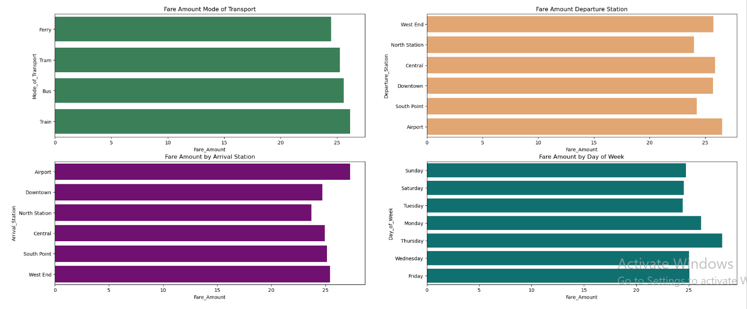
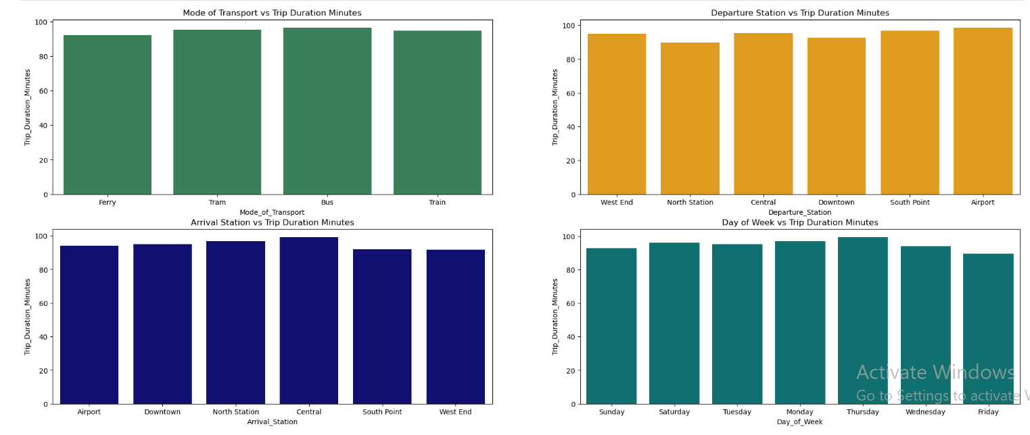
MetroMove Transit Solutions.
FARE PATTERNS
Flat, predictable fares (~$25).
Airport trips generate highest revenue, North Station the least.
Fare revenue not tied to passenger count or trip length.
Figure 6: Bar Chart Comparison of Categorical Features
Recommendations:
Keep fares affordable but add distance/time pricing.
Offer premium airport services.
Encourage ridership with discounts on low-demand days.
Figure 7: Bar Chart Comparison of Categorical Features

Slide 11


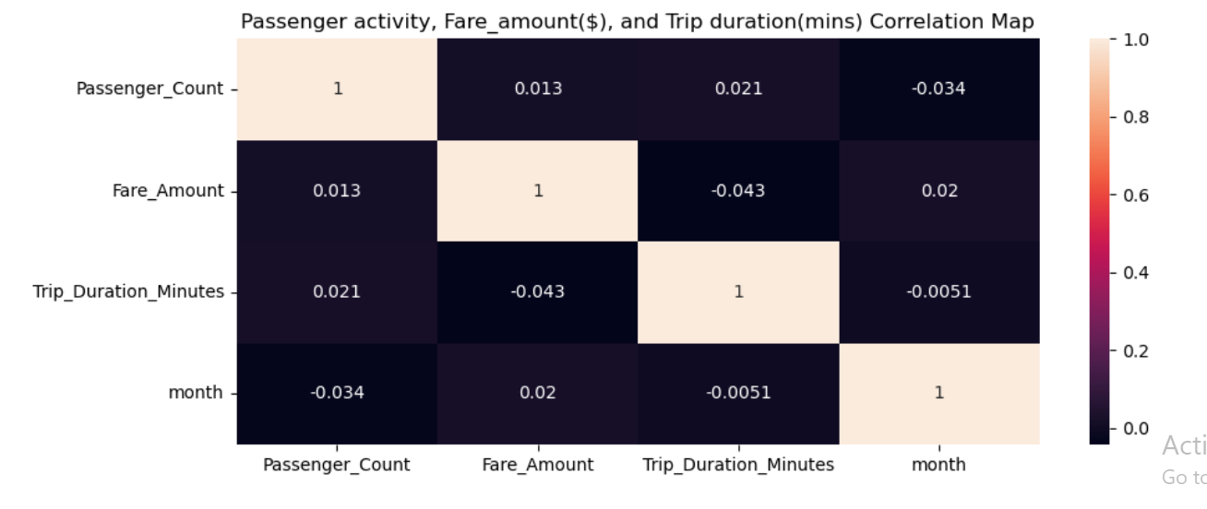
MetroMove Transit Solutions.
TRIP
PERFORMANCE INSIGHT
Average trip: 95–100 mins; wide variation.
Buses are slowest, ferries fastest.
Airport departures longest, North Station shortest.
Thursdays longest travel times, Fridays quickest.
Recommendations:
Prioritise buses with dedicated lanes/signals.
Launch Airport ↔ Central express routes.
Adjust schedules to match traffic patterns.

Slide 12
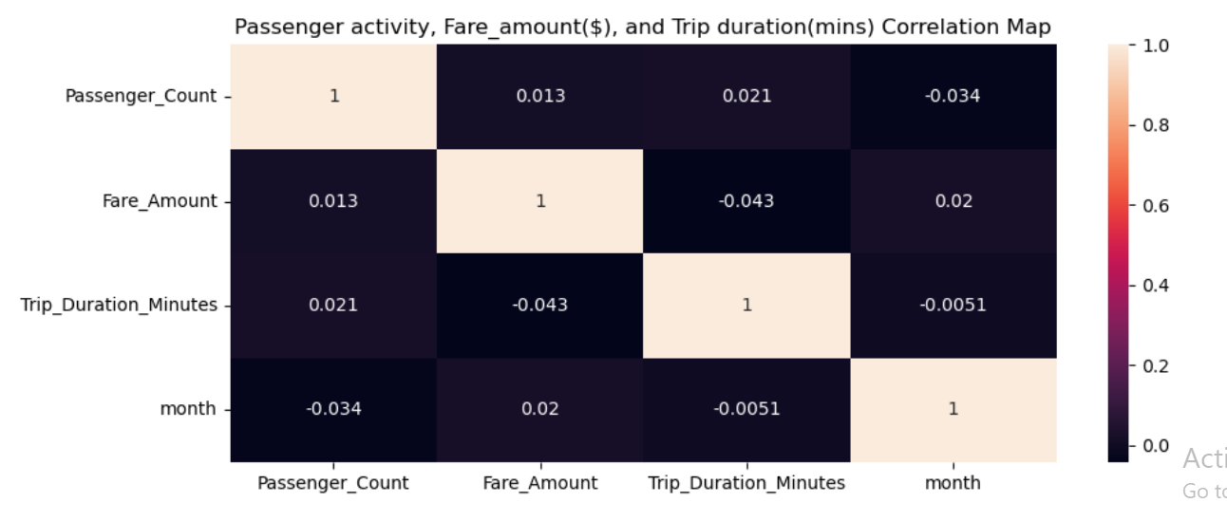
MetroMove Transit Solutions.
OVERALL EFFICIENCY INSIGHT
Recommendations:
Reallocate fleet to high-demand flows.
Redesign or consolidate weak routes.
Use real-time monitoring for schedules and pricing.
Figure 8: Heatmap Representation of Correlation Map
Passenger numbers, fares, and trip times not strongly connected.
Central ↔ Airport and North Station ↔ Airport dominate activity.
Some routes busy but low-revenue like Central.
Figure 9: Bar Chart Comparison of Categorical Features

Slide 13
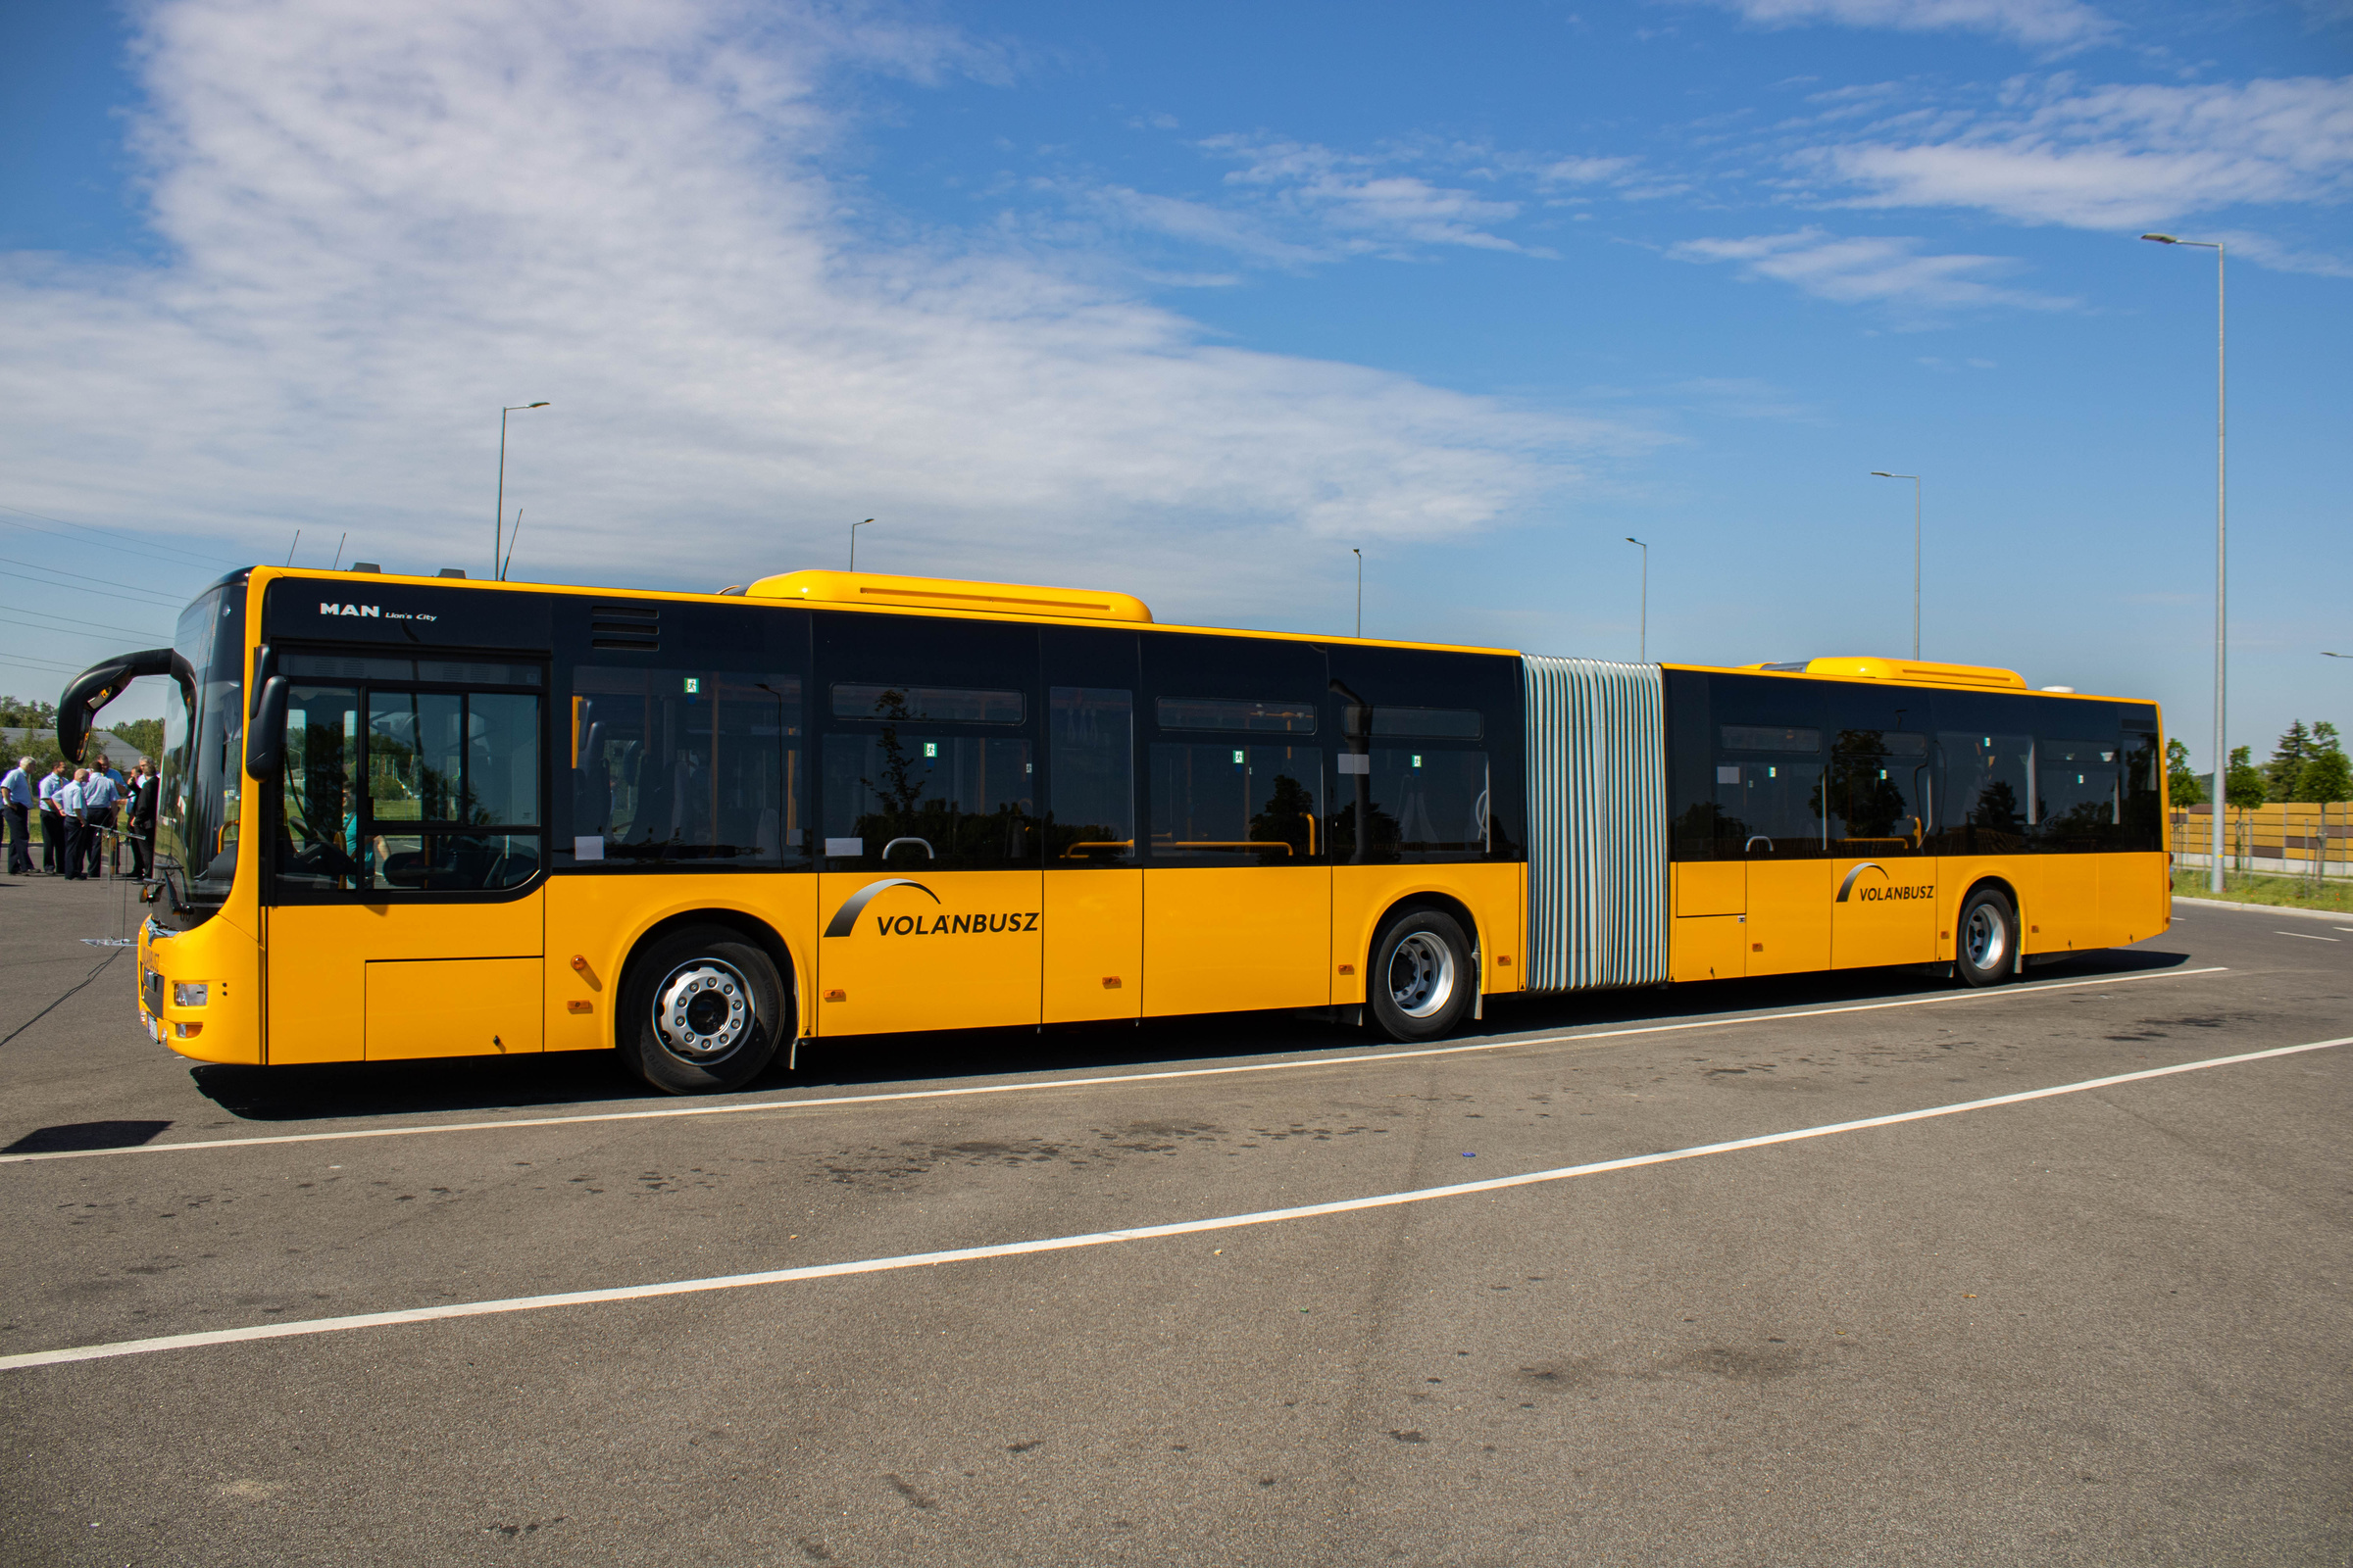

MetroMove Transit Solutions.
STRATEGIC ACTION FOR
METROMOVE
By focusing on busiest hubs, smarter pricing, reducing delays, and data-driven planning, MetroMove can deliver:
Efficiency: less congestion, better routes.
Affordability: fairer pricing for riders.
Timeliness: more reliable journeys.
Experience: smoother travel across the network.

Slide 14
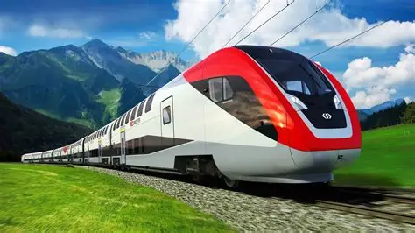


MetroMove Transit Solutions.
THANK YOU FOR LISTENING
TRAIN
FERRY
Presented By: Muinat Tijani
BUS
TRAM

